Slide 1
Rendering and Life Cycle Methods in React
G.Srikar
22H51A0582
CSE-B

Slide 2
Introduction to React Rendering
What is Rendering?
- React rendering updates the UI when component state or props change.
- Virtual DOM allows efficient updates.
How React Manages Updates - Re-renders only the components affected by state changes. - React compares the new Virtual DOM with the previous one (reconciliation).

Slide 3
Component Life Cycle Overview
Life Cycle Stages
- Mounting: When the component is created and inserted into the DOM.
- Updating: When component state or props change.
- Unmounting: When the component is removed from the DOM.

Slide 4
Mounting Phase
Methods in Mounting Phase
- constructor(): Initializes state and binds event handlers.
- static getDerivedStateFromProps(): Sync state with props (rarely used).
- render(): Returns JSX to define UI structure.
- componentDidMount(): Called after the component is mounted. Ideal for API calls or DOM manipulations.

Slide 5
Updating Phase
Methods in Updating Phase
- static getDerivedStateFromProps(): Used when the state depends on props.
- shouldComponentUpdate(): Determines whether the component should re-render.
- render(): Re-renders the UI based on new props or state.
- getSnapshotBeforeUpdate(): Captures some information before the DOM updates.
- componentDidUpdate(): Called after updates are reflected in the DOM.

Slide 6
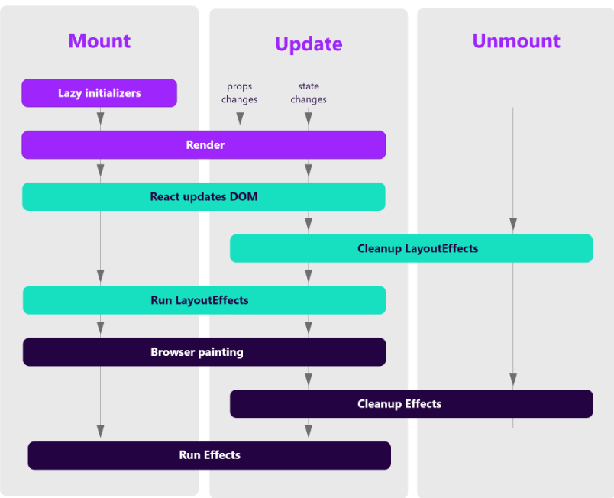
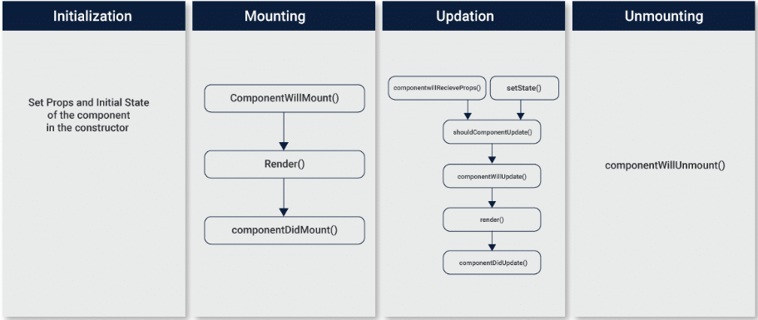
Unmounting Phase
Method in Unmounting Phase
- componentWillUnmount(): Clean up operations like cancelling network requests or removing event listeners.

Slide 7
Error Handling Methods
Handling Errors in Life Cycle
- componentDidCatch(error, info): Catches errors in child components during rendering.

Slide 8
React Hooks and Life Cycle
Using Hooks to Manage Life Cycle
- useEffect(): Combines behavior from componentDidMount, componentDidUpdate, and componentWillUnmount.
- useState(): Manages state in functional components.
Advantages of Hooks - Reduces code complexity. - Simplifies life cycle management in functional components.

Slide 9
Rendering Optimizations
Optimizing Performance
- Use React.memo to prevent unnecessary renders.
- Use shouldComponentUpdate or useCallback/useMemo in functional components.
- Code splitting with React.lazy for performance improvements.

Slide 10
Conclusion
Summary of life cycle stages.
Importance of understanding rendering for optimized performance.
How hooks have simplified life cycle management in modern React development.

